Slide 1

Neo Bank Churn Prediction
Using machine learning

Slide 2
Your best churn prediction model with higher recall on churning customers
- Onyia Ikechukwu Wilson

Slide 3
Executive Summary
Customer churn is a critical business challenge, impacting revenue and customer retention. This project aims to predict customer churn using machine learning, enabling proactive retention strategies.
I developed a LightGBM model, achieving 83% accuracy and 85% AUC-ROC, with key churn indicators including transaction gaps, tenure, transaction gap ratio, touchpoint, interest and so on. Feature engineering improved model performance, and a Streamlit app was deployed for real-time churn prediction. Insights reveal that customers with high transaction gap ratio and high tenure are at higher risk. The model provides actionable insights for targeted engagement, reducing churn. Future improvements include real-time data integration for enhanced decision-making.

Slide 4
Introduction
As I wrote in the executive summary customer churn is a critical challenge for businesses, impacting revenue and long-term growth. Identifying at-risk customers early allows companies to take proactive retention measures. This project leverages machine learning to predict churn based on transaction patterns, customer behavior, and engagement metrics. We chose this research question because traditional churn analysis is often reactive, whereas a data-driven approach enables early intervention. By analyzing historical data, we can uncover key churn indicators and develop a predictive model that helps businesses optimize customer retention strategies, improve engagement, and maximize lifetime value. As I heard in a marketing seminar I attended, it cost the financial institutions more to get a new customer than to retain an existing one. So, customer retention is a very big worry in our financial institutions.

Slide 5
Methods
Data Preprocessing and Feature Engineering
This project uses transaction and customer profile data to predict churn. The primary data source is historical transaction records, capturing deposits, withdrawals, and account activity. The secondary source includes customer attributes such as tenure, complaints, customer satisfaction touchpoints and so on. The data was gotten from Kaggle.com.
Data cleaning involved handling missing values, extracting values from a nested list and nested dictionary, removing redundant features, and engineering new features like days since last transaction, transaction frequency, activity gaps, and churn indicators.

Slide 6
Methods
Let me work you through the Data cleaning and feature Engineering
Churn is not defined in this project, my job included defining churn using a rule of thumb days since last transaction 365, if a customer haven’t had a transaction in 365 days we could classify the customer as churn. The Data is a time series data from 1st January 2008 to 31st December 2023 with almost 4 million rows and 26 columns and 106179 unique customers.
The touchpoint column is a nested list and customer satisfaction column is a nested dictionary with WhatsApp, Phone, Email and appointment as its key and a corresponding value. I had to drop the customer satisfaction column because 98% of the value is NaN.
New columns was created to help define churn which is days since last transaction and other columns helped predict churn and take actions earlier before a customer truly churn.

Slide 7
Methods
recent_activity, If days_since_last_txn ≤ 90, the customer has been active in the last 90 days. If days_since_last_txn > 90, they have been inactive for over 3 months. This feature could help follow up on the customer and try to improve the customer experience to reduce future churn likelihood.
txn_gap_ratio measures the proportion of inactivity compared to tenure for each customer. If a customer has been inactive for a long time but has short tenure, they are more likely to churn.
txn_gap_tenure combines inactivity and tenure to capture patterns. A low value means either short tenure or recent transactions, meaning lower churn risk.
transaction_frequency calculates the average number of transactions per day since the customer joined. Higher values = active customers, lower churn risk. Lower values = low activity, potential churn risk.
volume_per_transaction. It calculates the average amount of each customers transaction. Higher values = customers make fewer transactions, but larger amounts (could indicate long-term investors). Lower values = customers make frequent small transactions (likely engaged users).

Slide 8
Methods
For analysis, I tested multiple models, I used DummyClassifier as a baseline model, tested RandomForest, XGBoost, LightGBM, Catboost, LogisticRegression.
I applied LightGBM, a gradient boosting model optimized for speed and accuracy. This model was selected due to its ability to handle large datasets efficiently while capturing complex patterns, it had the best accuracy score 83%, best recall, precision, F1 and ROC-AUC score of 85%. I tuned hyperparameters to balance precision and recall, ensuring both high predictive power and practical business application.
Adjusted decision threshold to 0.35 to improve recall to 94% on churn customers.
I built an interactive Streamlit web app for real-time churn prediction, users can input customer details and receive a churn probability score.

Slide 9
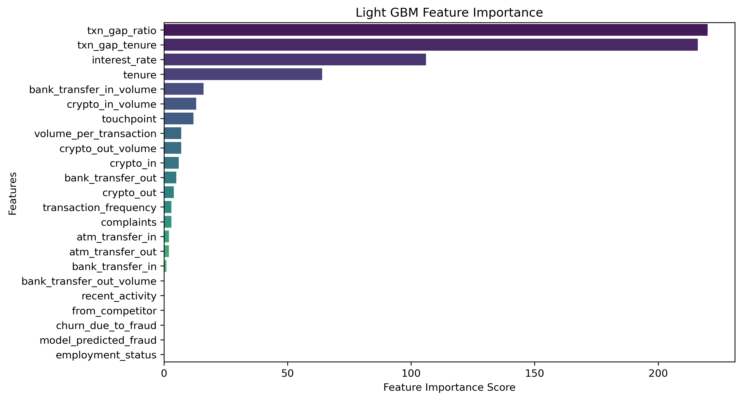
Results
The churn prediction model, trained using LightGBM, demonstrated strong performance, achieving an accuracy of 83% and an ROC-AUC score of 0.85. Feature importance analysis revealed that transaction gap ratio, transaction gap tenure, and interest rate were the most influential factors in predicting churn. This plot also showed feature with less impact on churn (i.e employment status, from competitor and so on.).

Slide 10
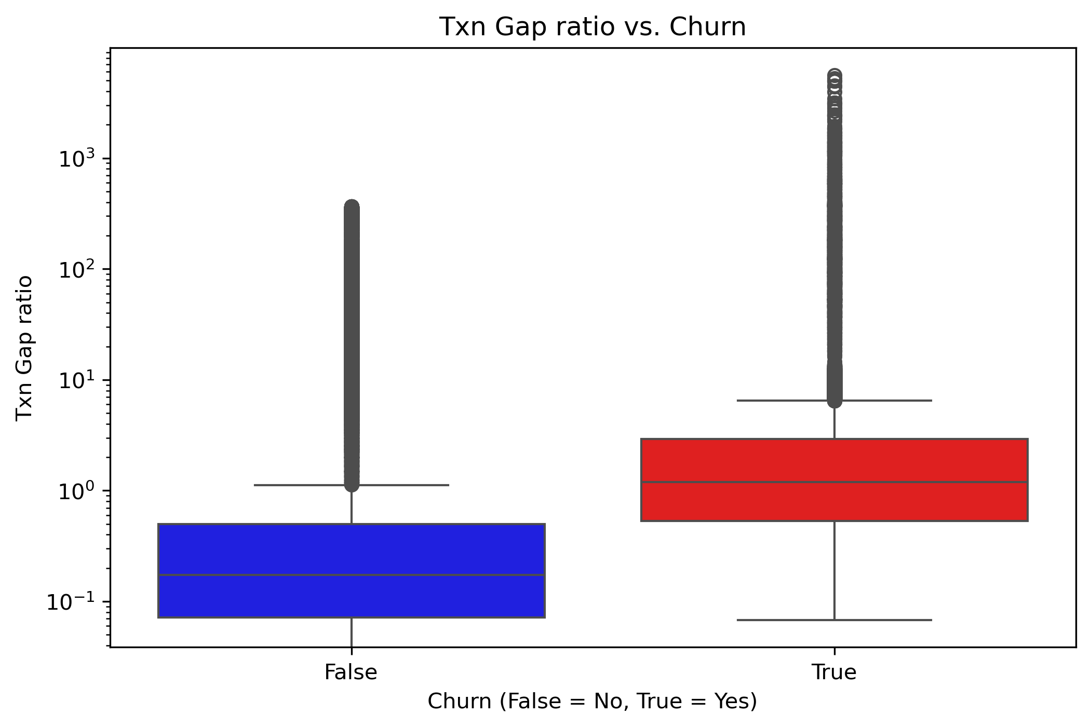
Results
Customer with higher transaction gap ratio are more likely to churn. This is a great insight as we need to look out for this, if transaction gap ratio increases beyond a set threshold the customer should be given attention to reduce churn risk.

Slide 11
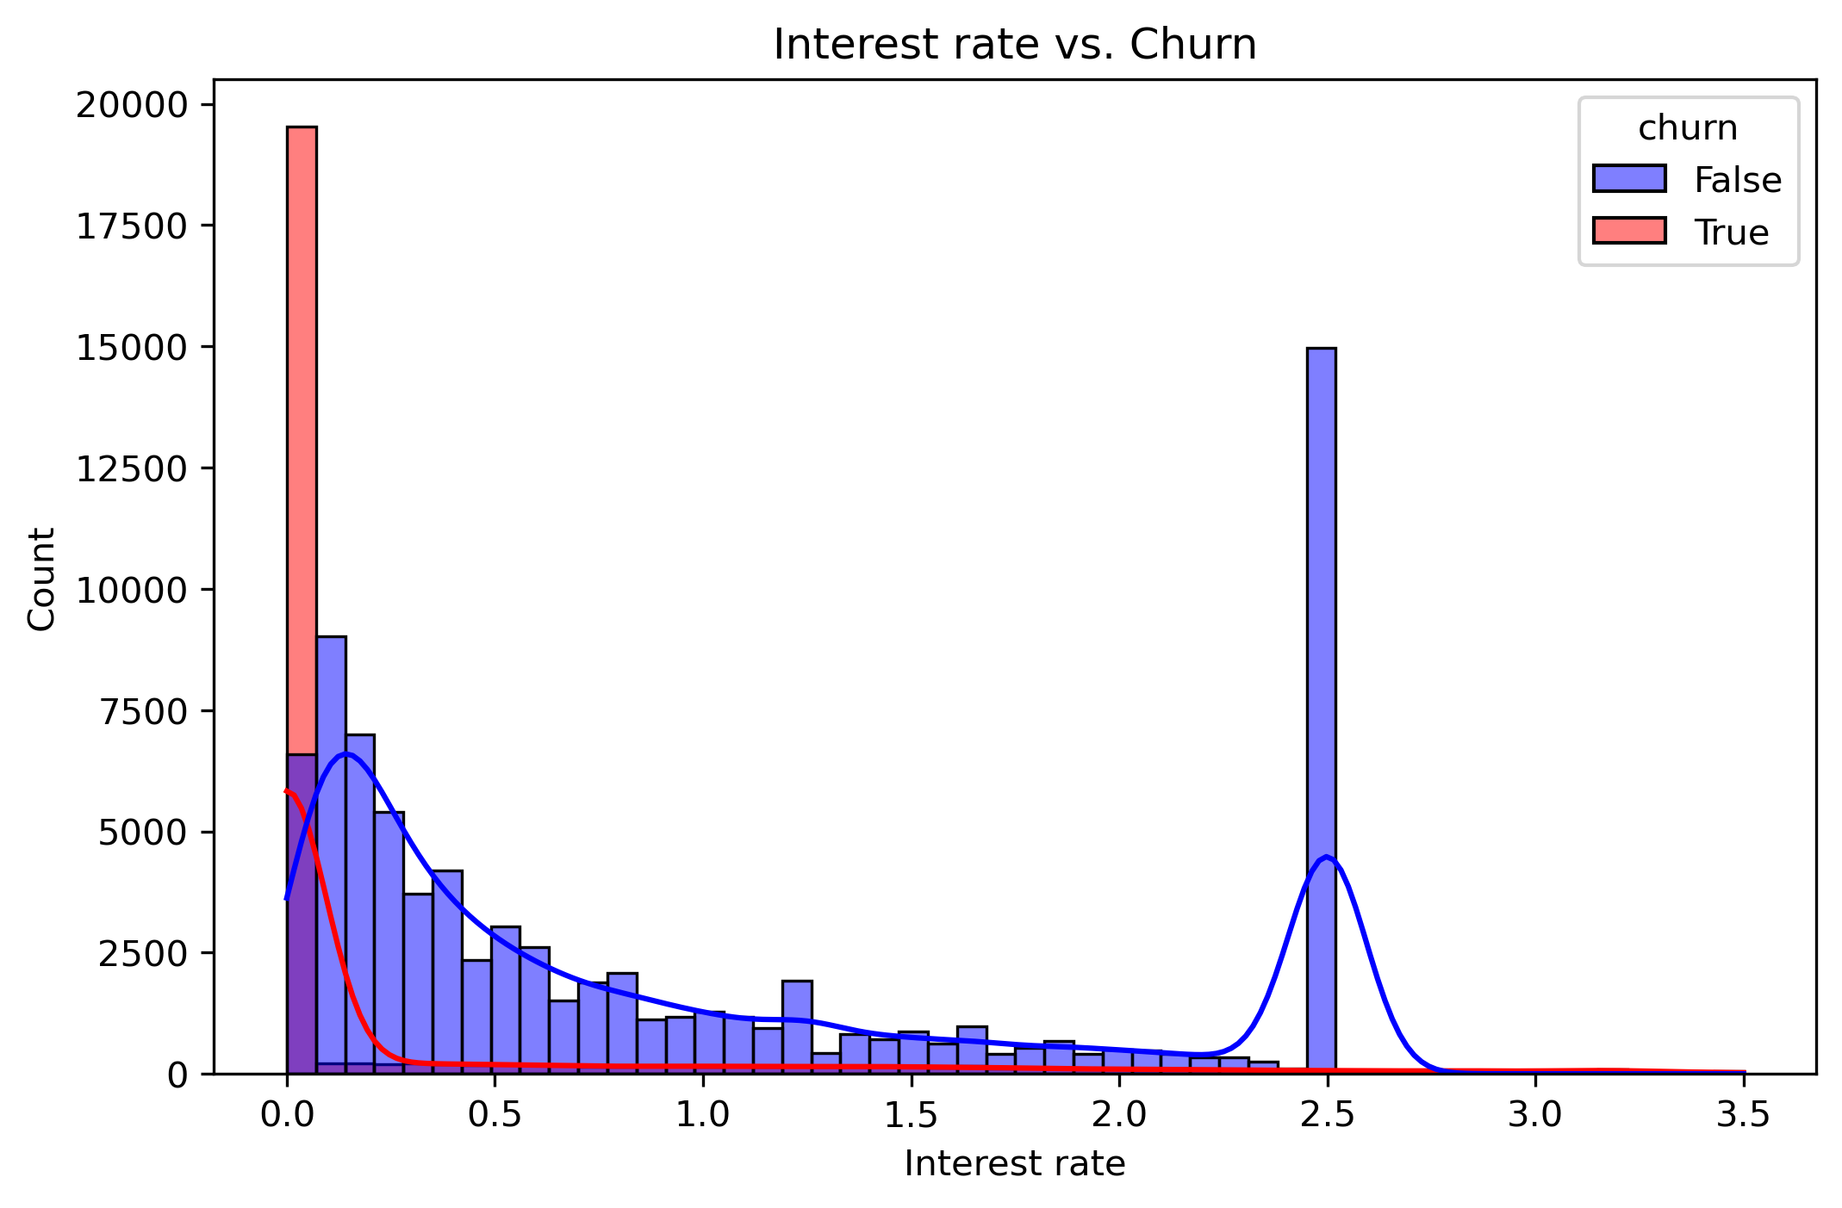
Results
This is a great insight; we could see that customers with zero or near zero interest indicates no activity and likely churn.
So, a customer with 0 interest over time is a risk of churn.

Slide 12
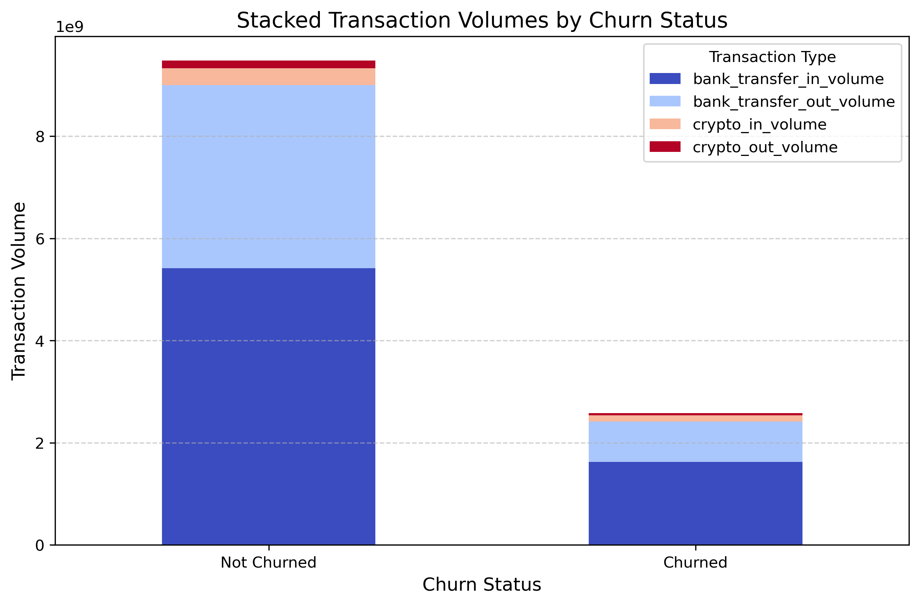
Results
Another great insight; customers with declining transactions are at risk of churn, attention should be given to customers with low or no transaction over a certain period of time.

Slide 13
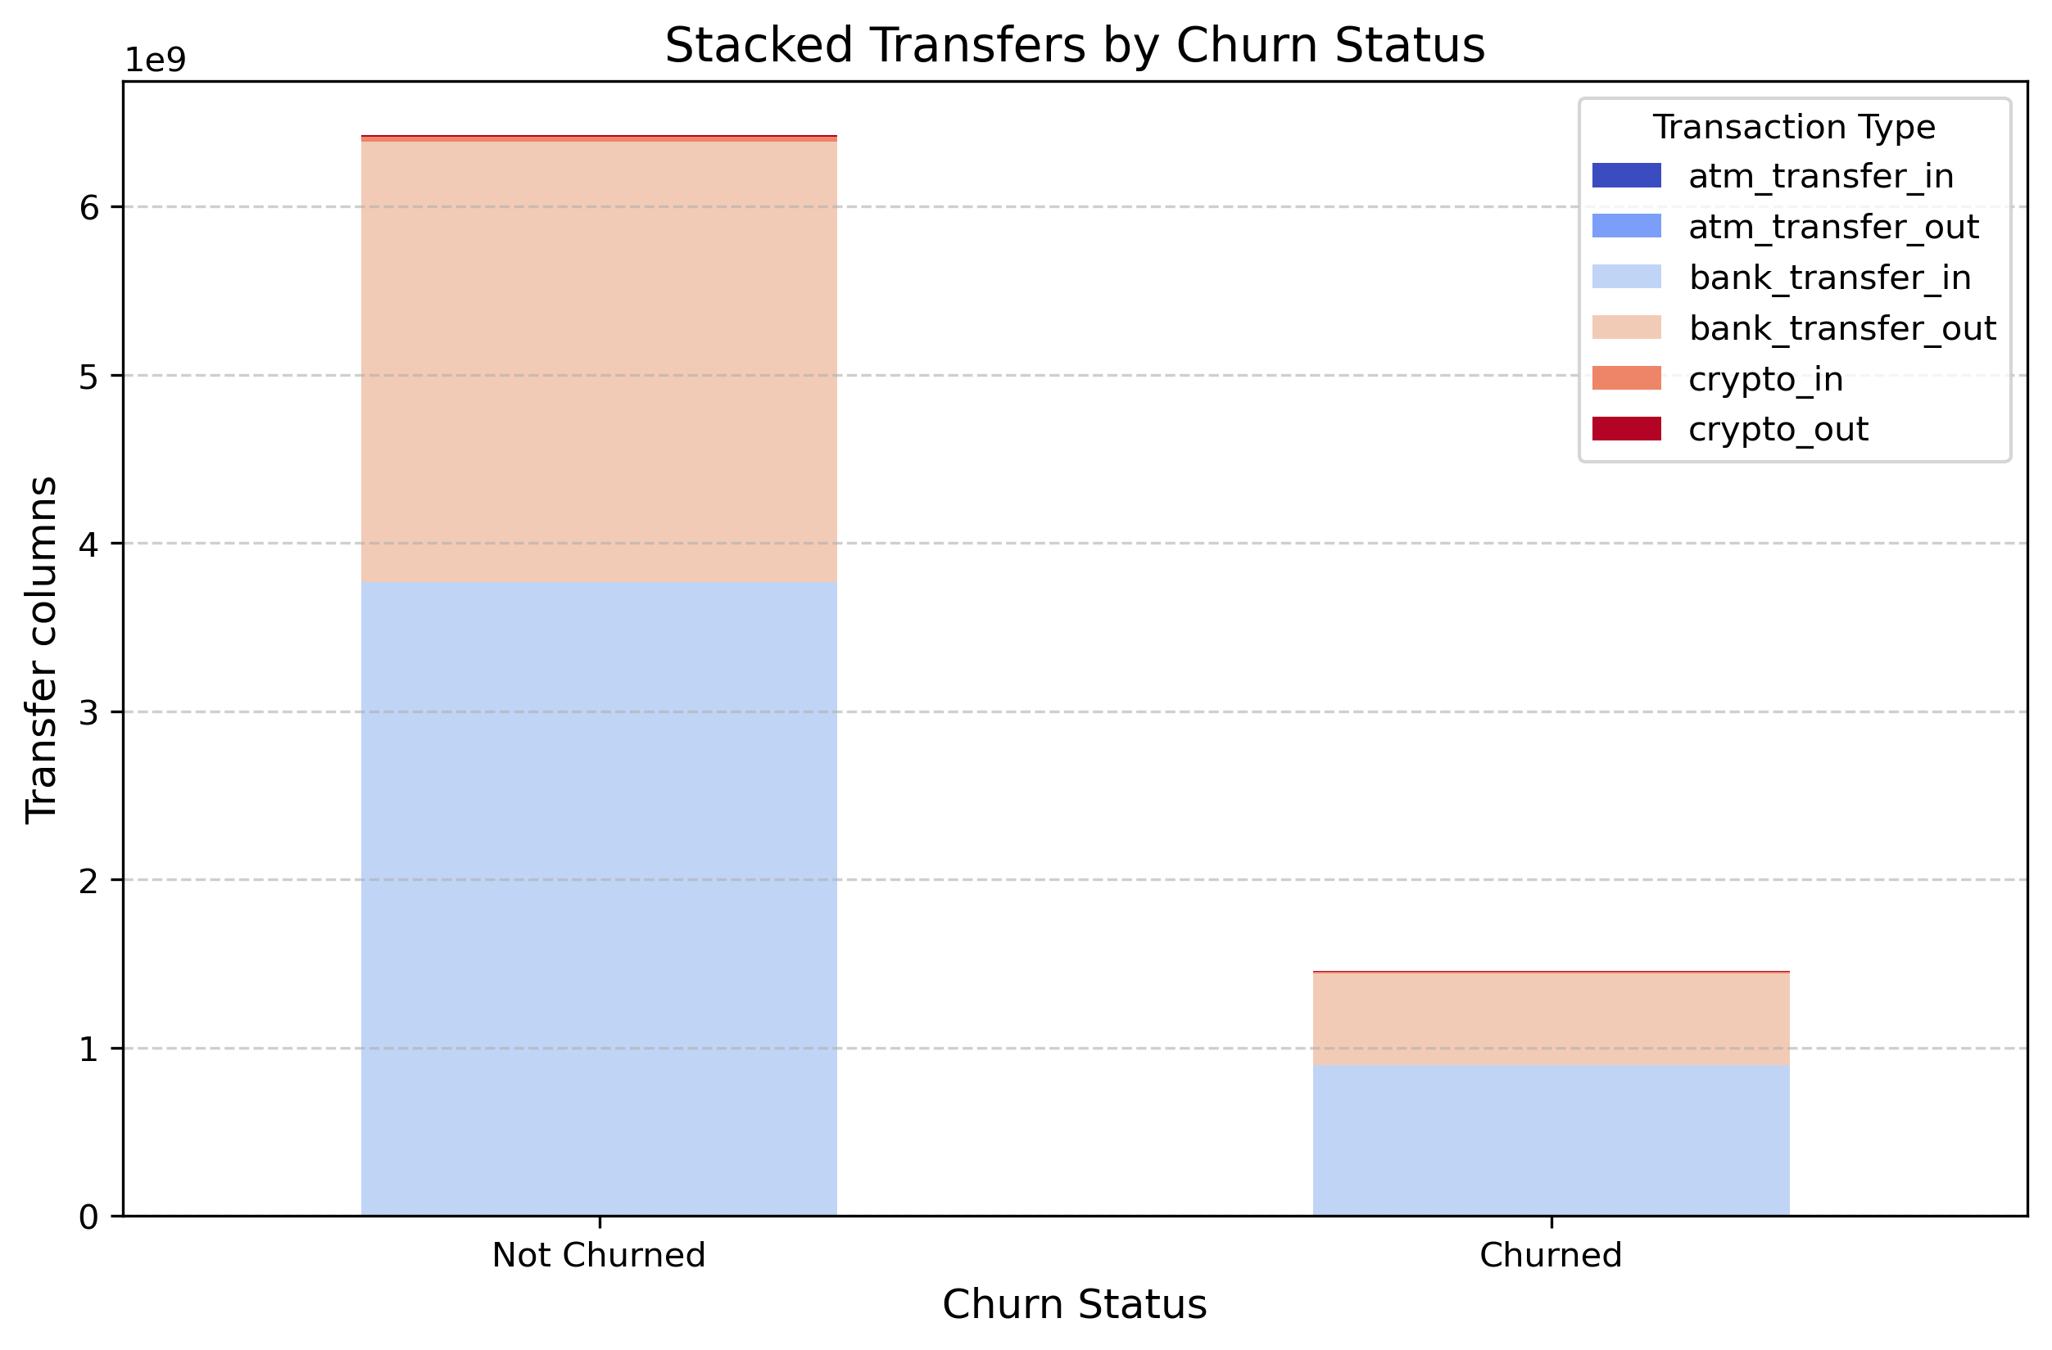
Results
Looking at the transfer columns, we could see that customers with lower ATM and crypto transfer activities are likely churners. A customer normally should have some sort of transfer activities either in or out of their account, so when this is low, it should become a concern.

Slide 14
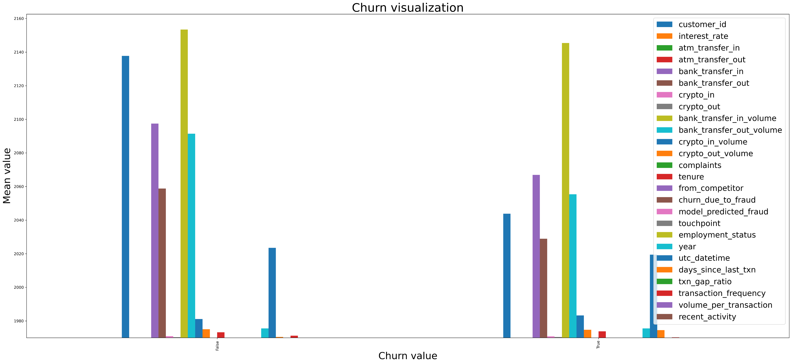
General overview of churn

Slide 15
Conclusion
This project successfully developed a machine learning model to predict customer churn with high accuracy. Key takeaways include the impact of transaction frequency, interest and tenure on churn probability.
Future steps include integrating additional behavioral data, such as customer support interactions, and implementing real-time monitoring to improve prediction accuracy. Additionally, A/B testing can be conducted to validate retention strategies suggested by the model’s insights.
Personalized retention strategies is another great recommendation, to use churn probabilities to segment customers and offer incentives, personalized messages, or better financial products.

Slide 16
Appendix
Id - unique id of this daily table
customer_id - unique customer_id
interest_rate - bank account interest rate on that day
name - name of the person
country - country of the person
date_of_birth - date of birth of the person
address - current address of the person
date - date of the events
atm_transfer_in - number of ATM pay-ins
atm_transfer_out - number of ATM withdrawals
bank_transfer_in - number of in-going transactions
bank_transfer_out - number of out-going transactions
crypto_in - number of buying-crypto transactions
crypto_out - number of selling-crypto transactions
bank_transfer_in_volume - total volume of in-going transactions
bank_transfer_out_volume - total volume of out-going transactions
crypto_in_volume - total volume of buying-crypto transactions
crypto_out_volume - total volume of selling-crypto transactions

Slide 17
Appendix
complaints - number of complaints made
touchpoints - list of support touchpoints the customer had that day (the list contains the channel name the customer reached out via)
csat_scores - customer satisfaction score the customer gave based on the support touchpoint. Nested dictionary with CSAT by support channel.
tenure - days since the customer signed a contract with the bank or had a product activity first time
from_competitor - flag indicating if customer came from competitor
job - customer's job title

